Slide 1
Combining
Diffie-Hellman &
Elliptic Curve Cryptography
Ryan Ng
Matthias
Ezra Ho
Kindly contact ryanngct [dot] dev [at] gmail [dot] com for authorization to reproduce.

Slide 2
Diffie Hellman (DH) Encryption
Method of securely exchanging cryptographic keys over a public channel
One of the first public-key protocols
Still widely used today
Key Advantage of DH: Communication can be done securely through an insecure channel
Key Disadvantage of DH: susceptible to Man-In-the-Middle Attacks as the attacker can claim to be the other party communicating
Does not allow for Authentication (Attacker can publish public key

Slide 3
Diffie Hellman (DH) Encryption
The users 1 and 2 pick out two DH parameters, prime number (p), base number (g) which is smaller than (p). These two parameters are known to all.
User 1 and 2 will then pick their own private numbers (random numbers (a) and (b)) which has to be smaller than (p-1)
User 1 compile A = g ^ a mod p and user 2 compiles B = g ^ b mod p. They then send the values A and B to each other.
User 1 will then compile s = B ^ a mod p and user 2 compile s = A ^ b mod p to each obtain the shared secret key.

Slide 4
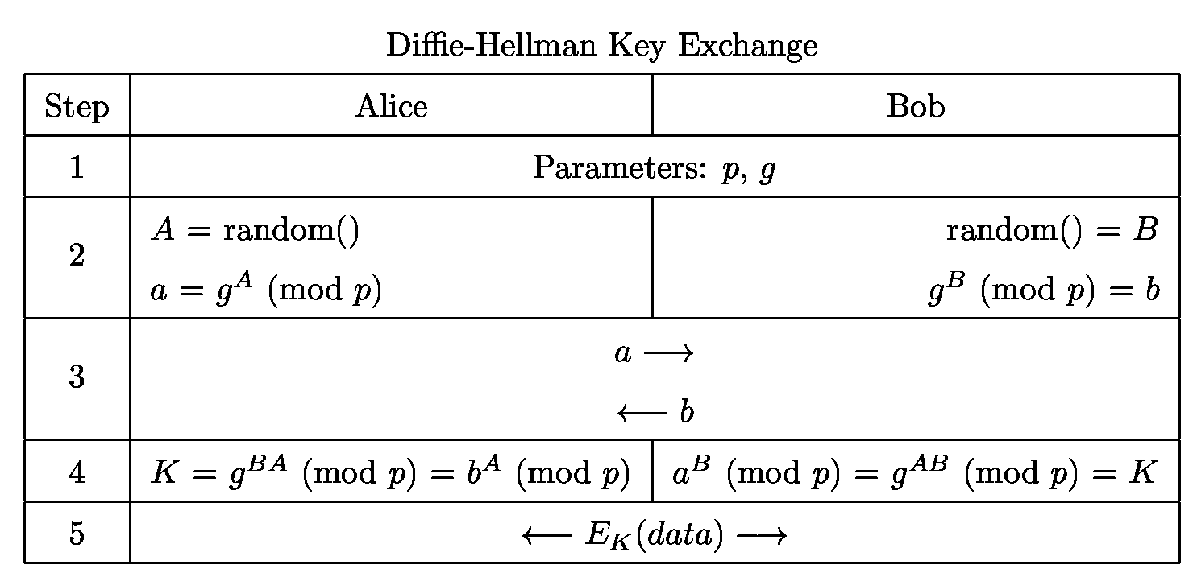
Diffie Hellman (DH) Encryption

Slide 5
Diffie Hellman Ephemeral (DHE) Encryption
This is a variation of the Diffie Hellman Key Exchange whereby the generated numbers from each user (a, b) are deleted after authentication. The shared keys shared between the users are also wiped after the session. This makes the key exchange extremely secure as there is no way to retrieve the values to obtain the variables needed to re-generate the exact same keys.

Slide 6
Diffie Hellman Ephemeral (DHE) Encryption
Perfect Forward Secrecy doable by DHE as the previous key sessions are unobtainable since it is replaced every session.
If one session is compromised, it would not affect the other sessions that has taken place beforehand thus is very secure.

Slide 7
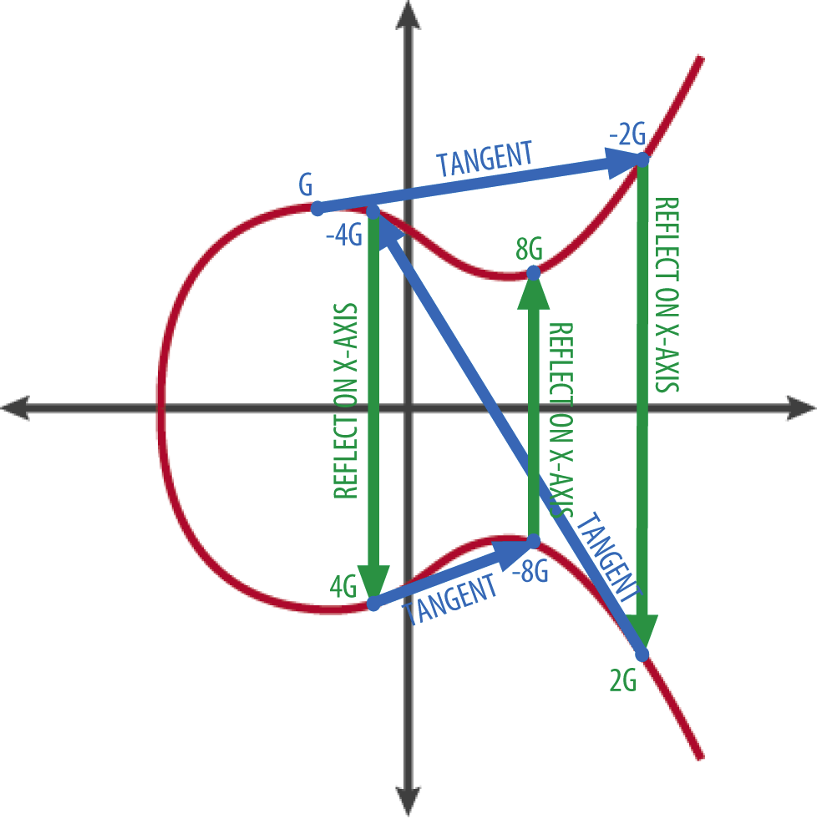
Elliptic Curve Cryptography (ECC)
ECC is a public key cryptography method which evolved from the DH Key Exchange. It is used in several integer factorization algorithms.
Key Advantage of ECC: Small key size. Faster, Less Storage, Compute Power required.
Key Disadvantage of ECC: Not supported by some browsers, pre defined curves are believed to have backdoors

Slide 8
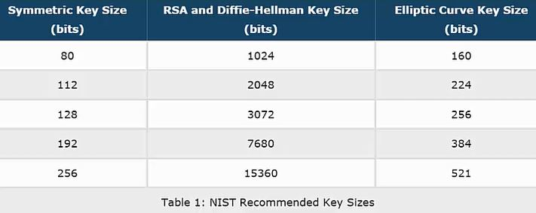
Elliptic Curve Cryptography (ECC)
The security of the ECC algorithm depends on the ability to compute the multiplicand given the original and product point.
The ECC algorithm requires far smaller key size than compared to RSA which reduces storage and transmission requirements yet still able to provide same level of security as RSA.

Slide 9
Elliptic Curve Cryptography (ECC)
Perfect Forward Secrecy is also found in ECC. This is a piece of the encryption system automatically and frequently changes the keys it uses to encrypt and decrypt information, such that if the latest key is compromised, it exposes only a small portion of the user’s sensitive data.
Perfect Forward Secrecy compliments ECC by generating a unique session key for each session a user initiates and ensures that the encryption of a specific session is unique and specific to that session.

Slide 10
Purpose of Elliptic Curve - Diffie Hellman (EC-DH) Encryption
Key Disadvantage of DH: susceptible to Man-In-the-Middle Attacks as the attacker can claim to be the other party communicating
Does not allow for Authentication (Attacker can publish public key
ECDH as a protocol of key exchange and secured communication
Elliptic curve generates Key pairs
Use of Point Addition makes it extremely difficult and computationally expensive to break (Discrete Log Problem)
Note: Point Addition is similar to modulo arithmetic (wrap arounds)
Allow for secure communication after generation of keys

Slide 11
Advantages of ECDH
ECDH solves the issue of man in the middle attacks present in the DH key exchange (needs to derive the secret key from base point).
Does not face the same issue of generating extremely large messages as ECC.

Slide 12
Disadvantages of ECDH
Not totally immune to imposters as non-repudiation and authentication are still not guaranteed. We fixed this issue by generating a new shared secret key for every message (one time use only). Can be further improved by combining ECDH with digital certificates.

Slide 13
Real World Applications of ECDH
Instant Messaging. ECDH is used to encrypt messages on popular instant messaging apps LINE and Signal.
Internet Communications. ECDH is one of the cipher suites offered in Transport Layer Security and OpenSSL.

Slide 14
The Code Demo

Slide 15
The High Level Overview of our Demo
Get Curve (brainpoolP256r1)
Generate Private Key using random point in curve
Generate Public Key using Point Addition
Exchange Public Keys
Plaintext retrieved is the same as ciphertext
Decryption to get plaintext
Encryption to get Ciphertext
Proof of Equality of Shared Keys
Generate shared keys (DH Concepts)

Slide 16
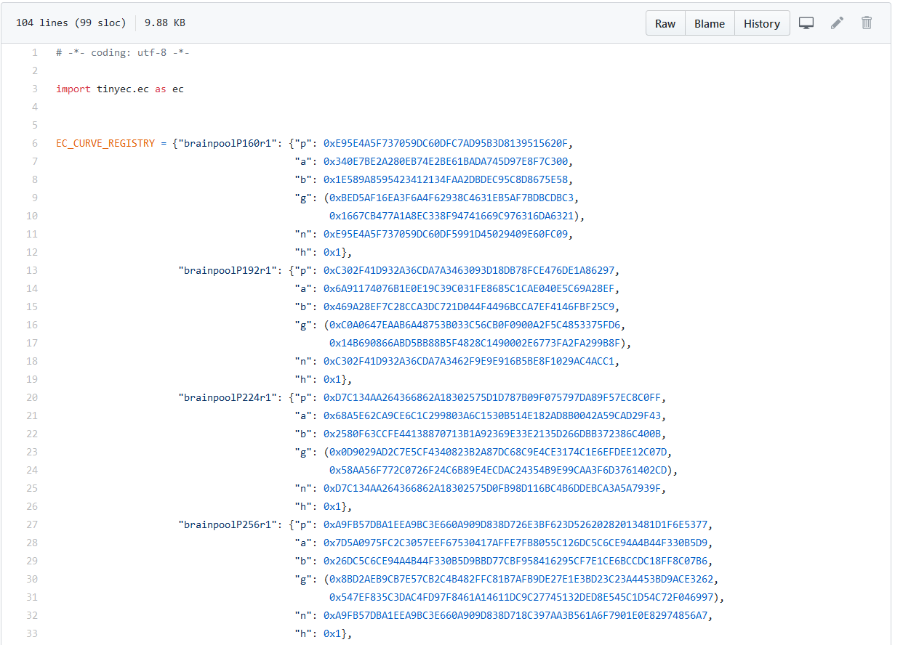
Github Repository we referenced (ECC)
We are able to use these curves by importing the tinyec python library
These curves were commissioned for use by NIST in the US
To install:
pip install tinyec
We will use this curve

Slide 17
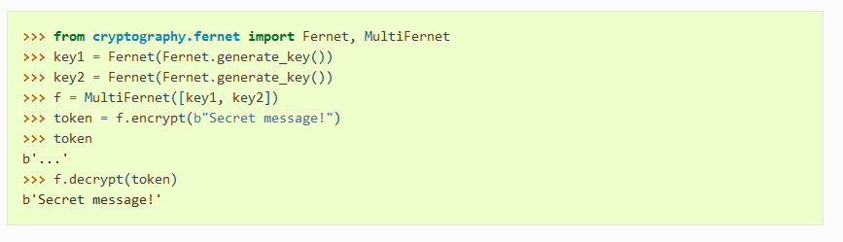
Github Repository we referenced (DH)
This is a symmetric encryption library that we will be using
To install: pip install cryptography

Slide 18
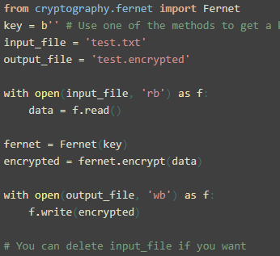
Problems with Encryption & Decryption
Fernet Symmetric Encryption Library requires a 32 byte/256-bit Base64 Encoded Byte string
Our shared key is 257-bits even after compression.
OH NO!!!😓😱

Slide 19
How to Resolve the problems
Use of SHA-256 algorithm to hash the secret key
Use of Base64 encoding for the digest
Digest will be used for encryption and decryption
Decryption: Same order for blue processes, reverse other processes
Encryption Process:
Encode to Byte String
Decode UTF-8
Message
Message
Encoded
Fernet Function
Ciphertext
Encrypt Encoded message
Encode to Byte String
SHA256
Encode to Base64
Secret Key
X coord
Secret Key
Encoded
Hash Digest
Hash Digest
Encoded

Slide 20
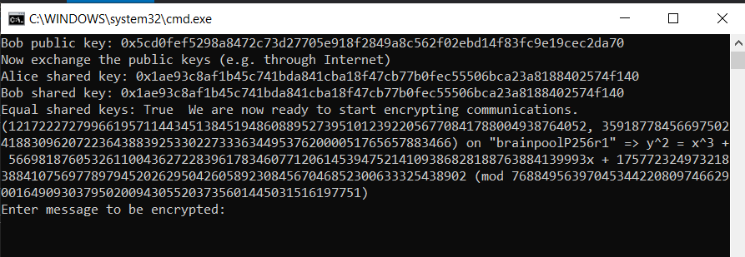
Why the use of secret key x coordinate?
Just casting the entire secret key to string does not make sense as the key comprises of the x coordinate , the y coordinate and the equation of the curve (y² = x³ + ax = b)

Slide 21
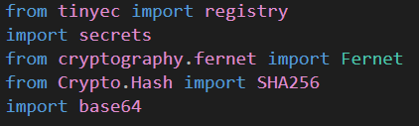
Updated Libraries to import
(for generating random private key)

Slide 22
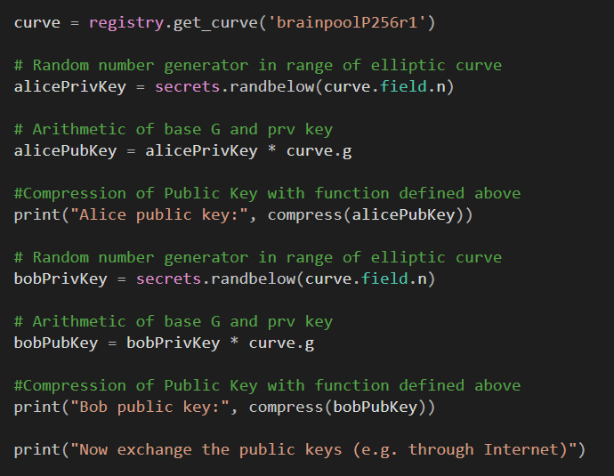
Compress is a function

Slide 23
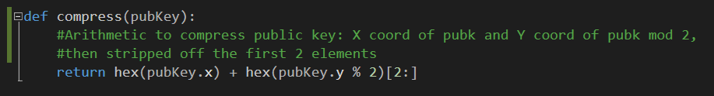
Compress Function

Slide 24
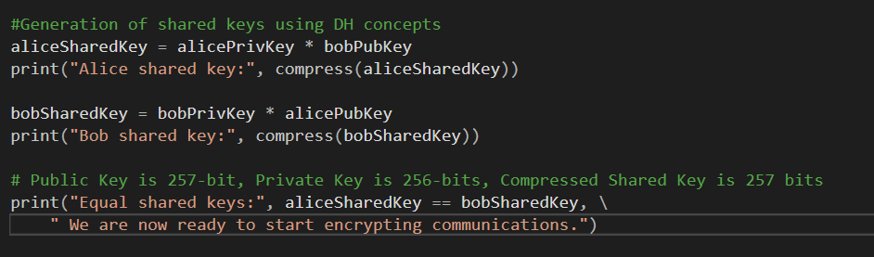
Shared Key Generation

Slide 25

Encryption Function Call

Slide 26
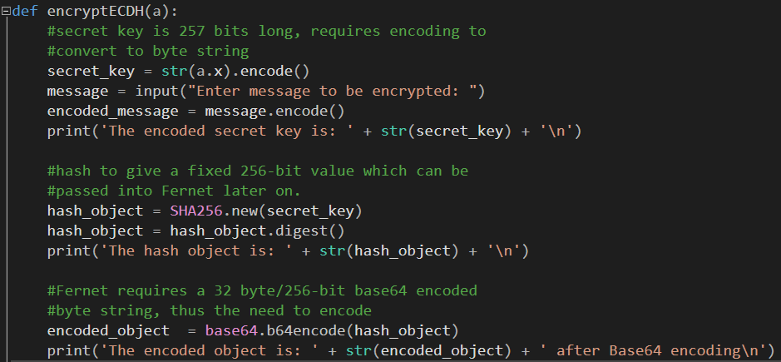
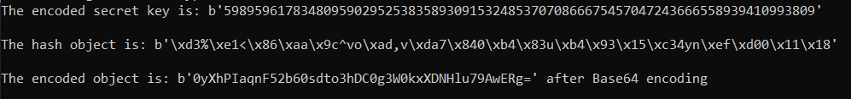
Encryption

Slide 27
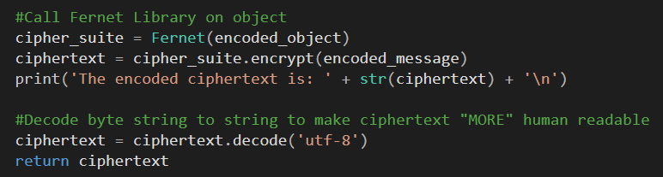
Encryption (Continued)

Slide 28

Decryption Function Call

Slide 29
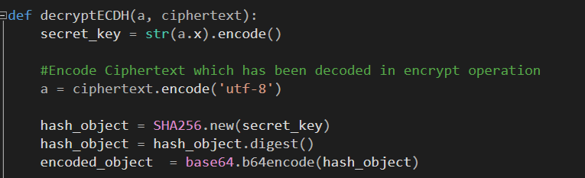
Decryption

Slide 30
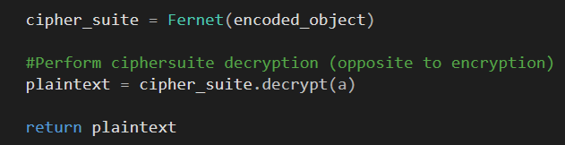
Decryption (Continued)

Slide 31
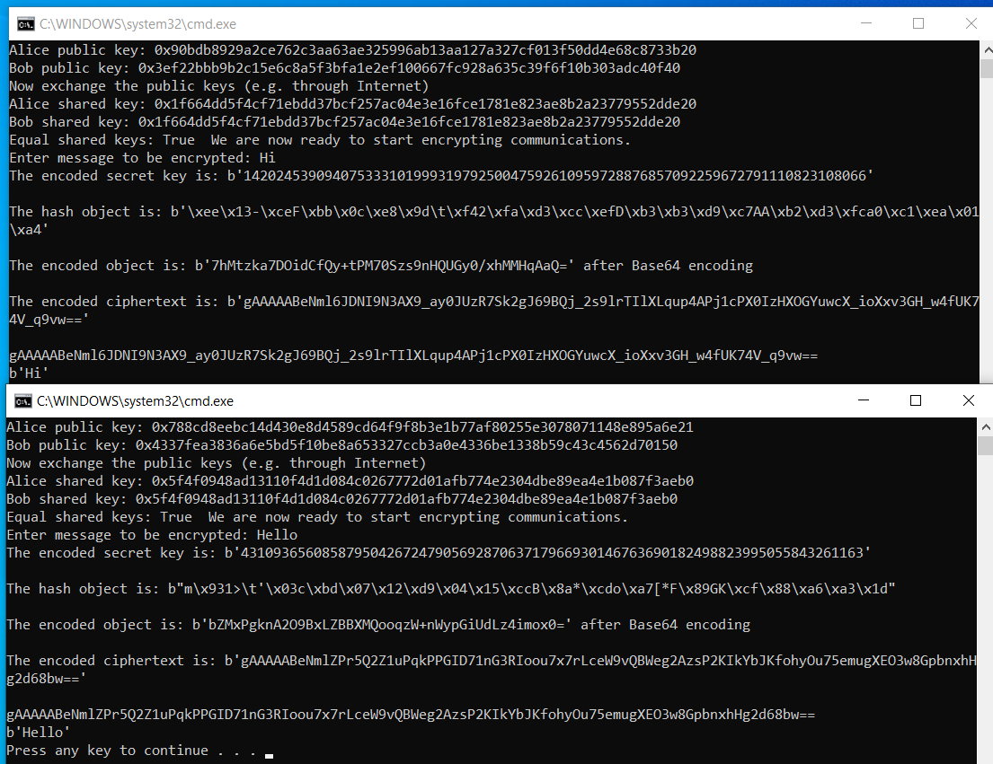
Results
Keys generated every time the program runs is different

Slide 32
Thank You for your attention!
Kindly contact ryanngct [dot] dev [at] gmail [dot] com for authorization to reproduce.

